Slide 1

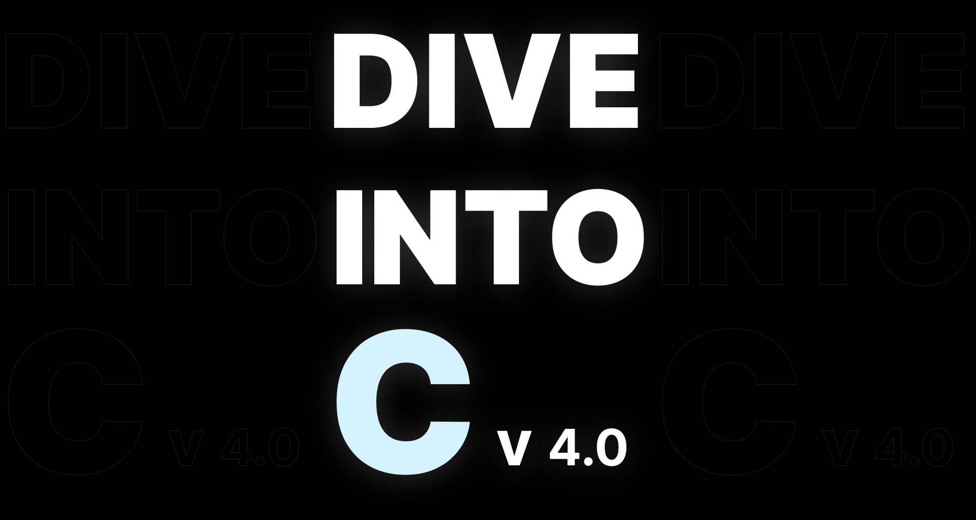


Slide 2
Variables

Slide 3
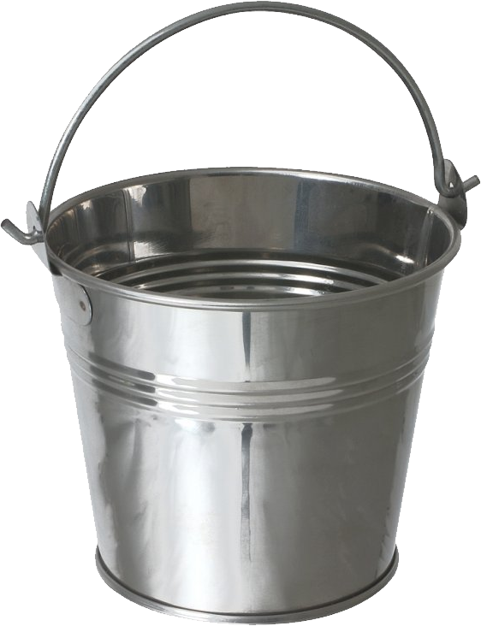

What is a Variable ?
A memory location
A Container

Slide 4
Every variable has a
Name | Type | Size | Value

Slide 5
Variable Types
Int
float
double
char
bool
2
2.540000
2.4443434
“C”
True / False

Slide 6
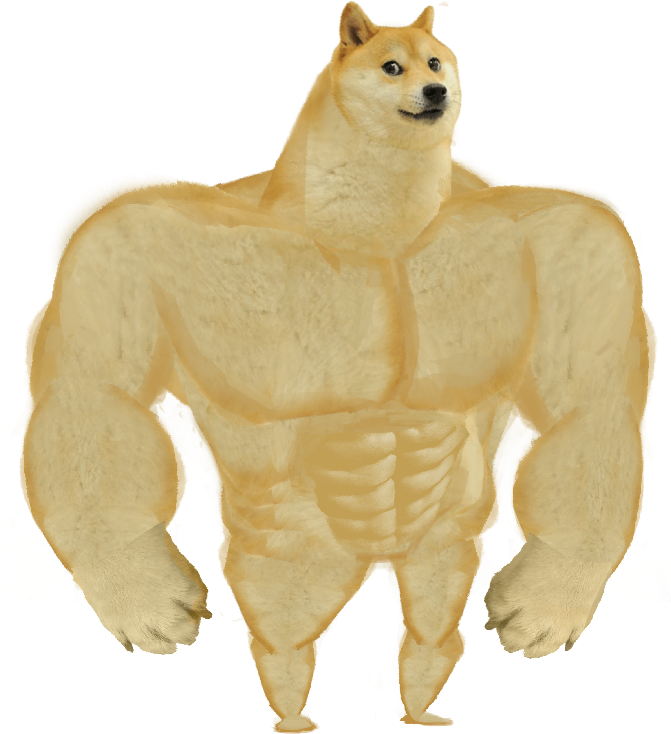
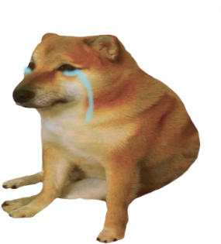
Variable Naming
Valid
Invalid
num
_num
Num
num_
num_1
1num
+num
num_*

Slide 7
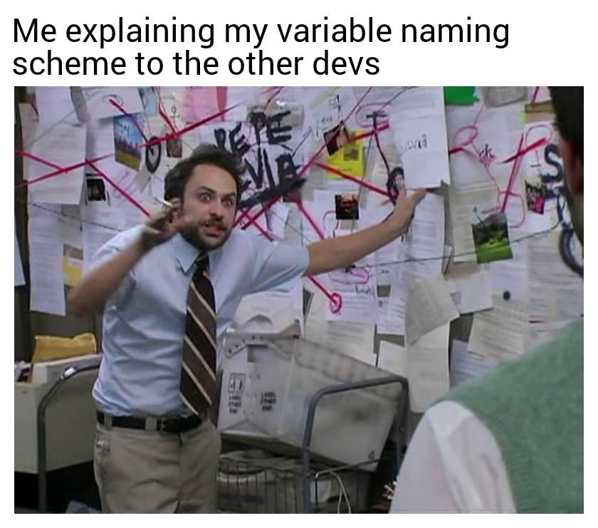

Slide 8
Code::Blocks

Slide 9
Basic Structure

Slide 10
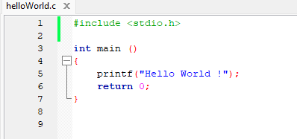
Preprocessor Directive
Method
Body
Return Value

Slide 11

Then, Let’s CODE !

Slide 12
Problem 1
Print your name & batch in the same line
Print your name & batch in two lines

Slide 13
Data types & Variable Declaration
Data Type | printf | scanf
int | %d | %d
float | %f | %f
double | %f | &%lf
char | %c | %c
char [n] | %s | %s

Slide 14
Problem 2
Create a program to Enter your,
Favorite number,
Favorite letter &
Get the output

Slide 15
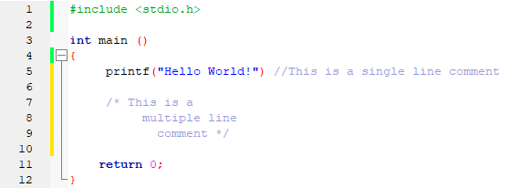
Comments

Slide 16
Problem 3
Enter two numbers & swap them
(Print before swap & after swap)

Slide 17
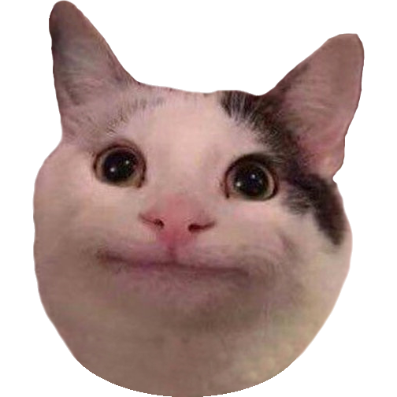
A
B

Slide 18
A
B
Temp

Slide 19
A
B
Temp

Slide 20
A
B
Temp

Slide 21
A
B
Temp

Slide 22
Operators

Slide 23
Types of operators
Increment /
Decrement
Arithmetic
Logical
Relational
Assignment

Slide 24
Arithmetic | Relational | Logical | Assignment | Inc / Dec
+ | > | && | ₊₌ | ++
- | < | || | -+ | --
* | >= | ! | *=
/ | <= |  | /=
% | ==
 | !=

Slide 25
Problem 4
Write a program to get marks of three subjects & find the average.

Slide 26
Control Structures

Slide 27
Control Structures
Iteration
- while
- do while
- for
Sequence
Selection
-if
-switch

Slide 28
Sequence

Slide 29
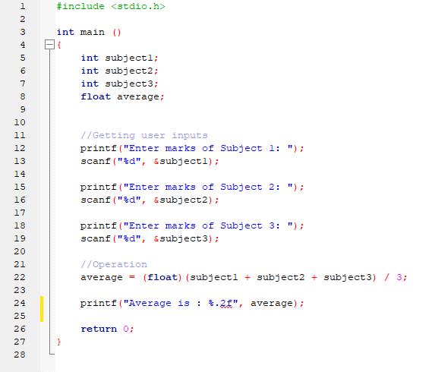
Top
Bottom

Slide 30
Selection

Slide 31
Problem 5
Write a program to print “True” if user entered number is “7”, if not print “False”

Slide 32
Problem 6
Enter student marks,
If marks are
< 40 print “Fail”
If not print “Pass”

Slide 33
Problem 7
Enter student marks & get the Grades
If marks,
>=75 : A
>=65 : B
>=50 : C
<50 : F

Slide 34
Problem 8
Write a program to print the month name when user enter a month number.

Slide 35
Iteration

Slide 36

while
for
Do while

Slide 37
While Loop - Syntax
while (condition)
{
//body
}

Slide 38
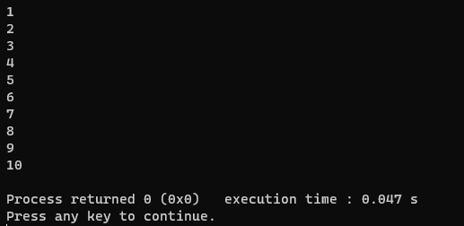
Problem 9
Print 1 to 10 integer numbers using a while loop

Slide 39
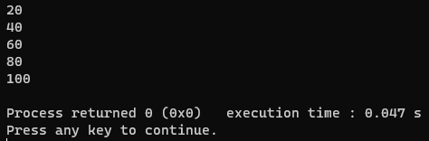
Problem 10
Print multiples of 20 from 1 to 100

Slide 40
Problem 11
Write a program to get 10 numbers from user & print the total (using while loop)

Slide 41
Problem 12
Write a program to print “True” when entering any number. If user enters “-1”, the program must stop by itself.
(Iterate the number entering by using while loop and break it when user entered -1)

Slide 42
Problem 13
Let’s Make a Calculator.
Get two numbers from the user & ask what operation they need to do (1 - Sum, 2 – Sub, 3 – Mul…). After selecting the operation print the necessary output. If user enters “-1” as an input in the menu, exit the program.

Slide 43
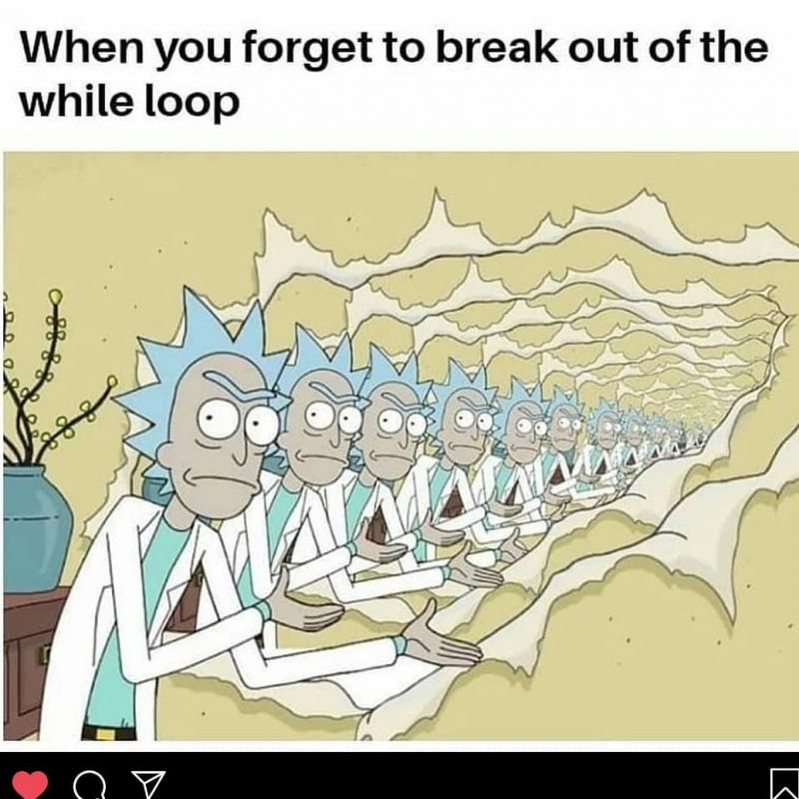

Slide 44
Do While Loop - Syntax
do
{
//body
}while(condition);

Slide 45
Problem 14
Write a program to input marks of 10 students for a module & display the number of students who successfully completed the program. Pass mark is 50
(Using Do While Loop )

Slide 46
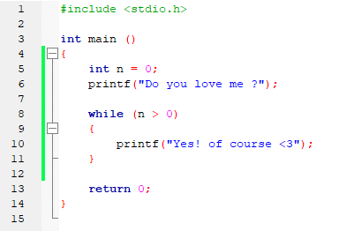
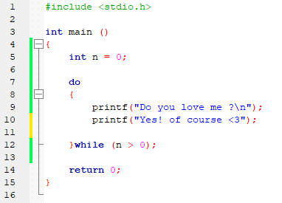

Slide 47
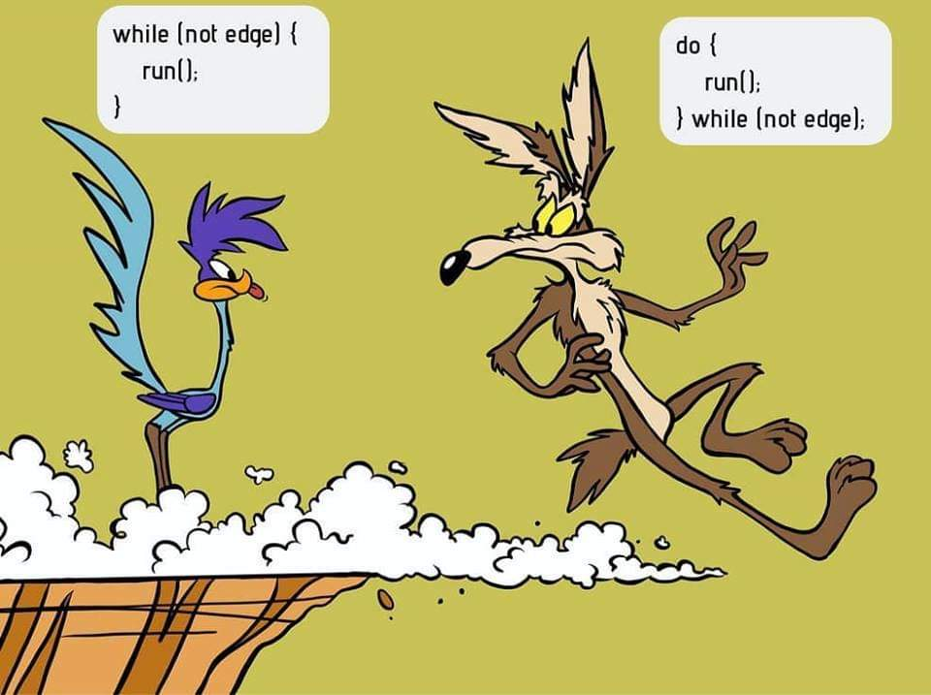

Slide 48
For Loop - Syntax
for (condition)
{
//body
};

Slide 49
Problem 15
Write a program to print 1 to 100 using a for loop

Slide 50
Problem 16
Write a program to get 10 user input values & print them.

Slide 51
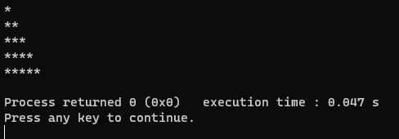
Problem 17
Write a program to get the following output.

Slide 52
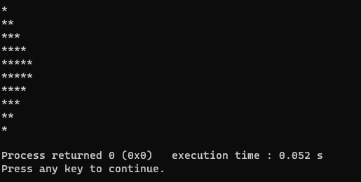
Problem 18
Modify the above code to get the following output.

Slide 53
Arrays

Slide 54
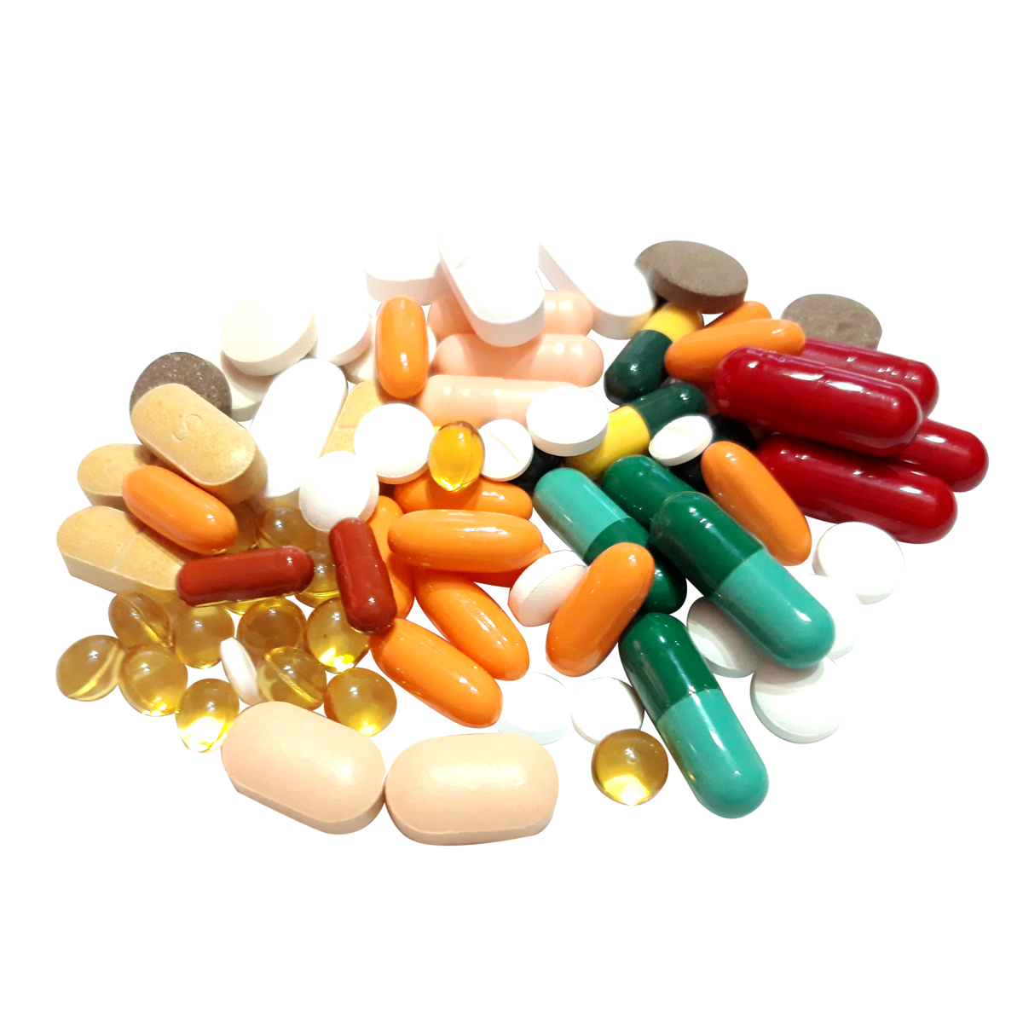

Slide 55
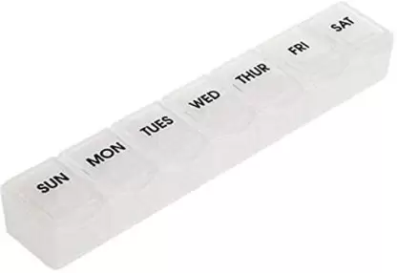

Slide 56
What is an Array?
A data Structure
An array is used to store set of values with same data types.

Slide 57
Arrays
Single Dimensional
Arrays
Multi Dimensional
Arrays

Slide 58
Single Dimensional Arrays

Slide 59
Index Number
0
1
2
3
4

Slide 60
Storing values
Store 10, 21, 60, 9, 11 in a single dimensional array

Slide 61
0
1
2
3
4

Slide 62
0
1
2
3
4
10

Slide 63
0
1
2
3
4
10 | 21

Slide 64
0
1
2
3
4
10 | 21 | 60

Slide 65
0
1
2
3
4
10 | 21 | 60 | 9

Slide 66
0
1
2
3
4
10 | 21 | 60 | 9 | 11

Slide 67
0
1
2
3
4
10 | 21 | 60 | 9 | 11
Element

Slide 68
Declaration
DataType ArrayName[arraySize];
Int arr[5];

Slide 69
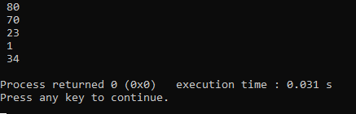
Problem 19
Declare an array to store 80, 70, 23, 1, 34 and print the array.

Slide 70
Problem 20
Get user values for an array size of 10 and print the values.

Slide 71
Problem 21
Declare an array to get marks for a module from 10 students and print the total and the average marks of those students.

Slide 72
Problem 22
Declare two arrays(array size = 5) and add those two arrays. Assign the sum of those values into a third array.
Array 1 = 10,20,30,40,50
Array 2 = 11,22,33,44,55

Slide 73
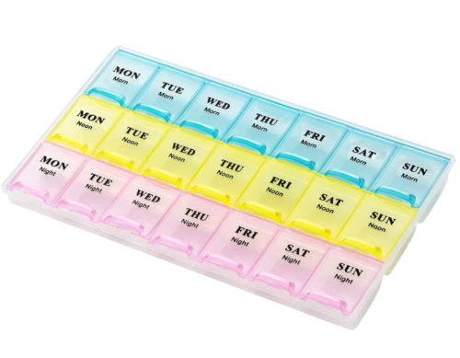
Multi Dimensional Arrays

Slide 74
Rows

Slide 75
Columns

Slide 76
Index Numbers
0
1
2
3
0
1
2

Slide 77
Storing values
Store 10, 21, 60, 9, 11, 2, 4, 10, 3, 45, 65, 9 in a two dimensional array

Slide 78
0
1
2
3
0
1
2

Slide 79
0
1
2
3
10
0
1
2

Slide 80
0
1
2
3
10 | 21
0
1
2

Slide 81
0
1
2
3
10 | 21 | 60
0
1
2

Slide 82
0
1
2
3
10 | 21 | 60 | 9
0
1
2

Slide 83
0
1
2
3
10 | 21 | 60 | 9
11 | 2 | 4 | 10
0
1
2

Slide 84
0
1
2
3
10 | 21 | 60 | 9
11 | 2 | 4 | 10
3 | 45 | 65 | 9
0
1
2

Slide 85
0
1
2
3
10 | 21 | 60 | 9
11 | 2 | 4 | 10
3 | 45 | 65 | 9
0
1
2
(0,2)

Slide 86
0
1
2
3
10 | 21 | 60 | 9
11 | 2 | 4 | 10
3 | 45 | 65 | 9
0
1
2
(0,2)

Slide 87
0
1
2
3
10 | 21 | 60 | 9
11 | 2 | 4 | 10
3 | 45 | 65 | 9
0
1
2
(2,1)

Slide 88
0
1
2
3
10 | 21 | 60 | 9
11 | 2 | 4 | 10
3 | 45 | 65 | 9
0
1
2
(1,1)

Slide 89
0
1
2
3
10 | 21 | 60 | 9
11 | 2 | 4 | 10
3 | 45 | 65 | 9
0
1
2
(1,1)

Slide 90
Declaration
DataType ArrayName[Rows][Columns];
Int arr[3][2];

Slide 91
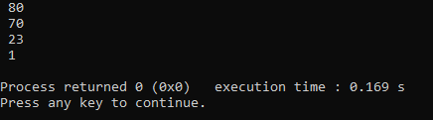
Problem 23
Declare a 2D array which contains two rows and two columns to store 80, 70, 23, 1 and print the array.

Slide 92
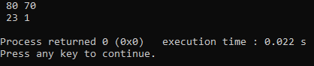
Problem 24
Print the previous array as a matrix

Slide 93
Problem 25
Declare a 2D array which contains three rows and two columns and get user inputs. After getting inputs display the array elements in 3x2 matrix

Slide 94
Problem 26
Get the sum of following 2D arrays and assign the values into a third array.
Print the output of the third array.
Array 01 = 10, 20, 30, 40
Array 02 = 11, 22, 33, 44

Slide 95
Functions

Slide 96
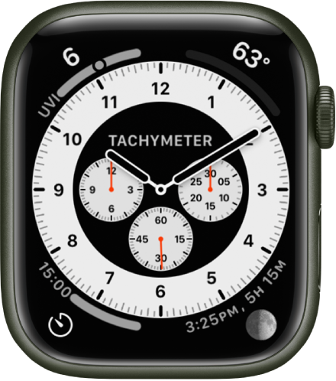
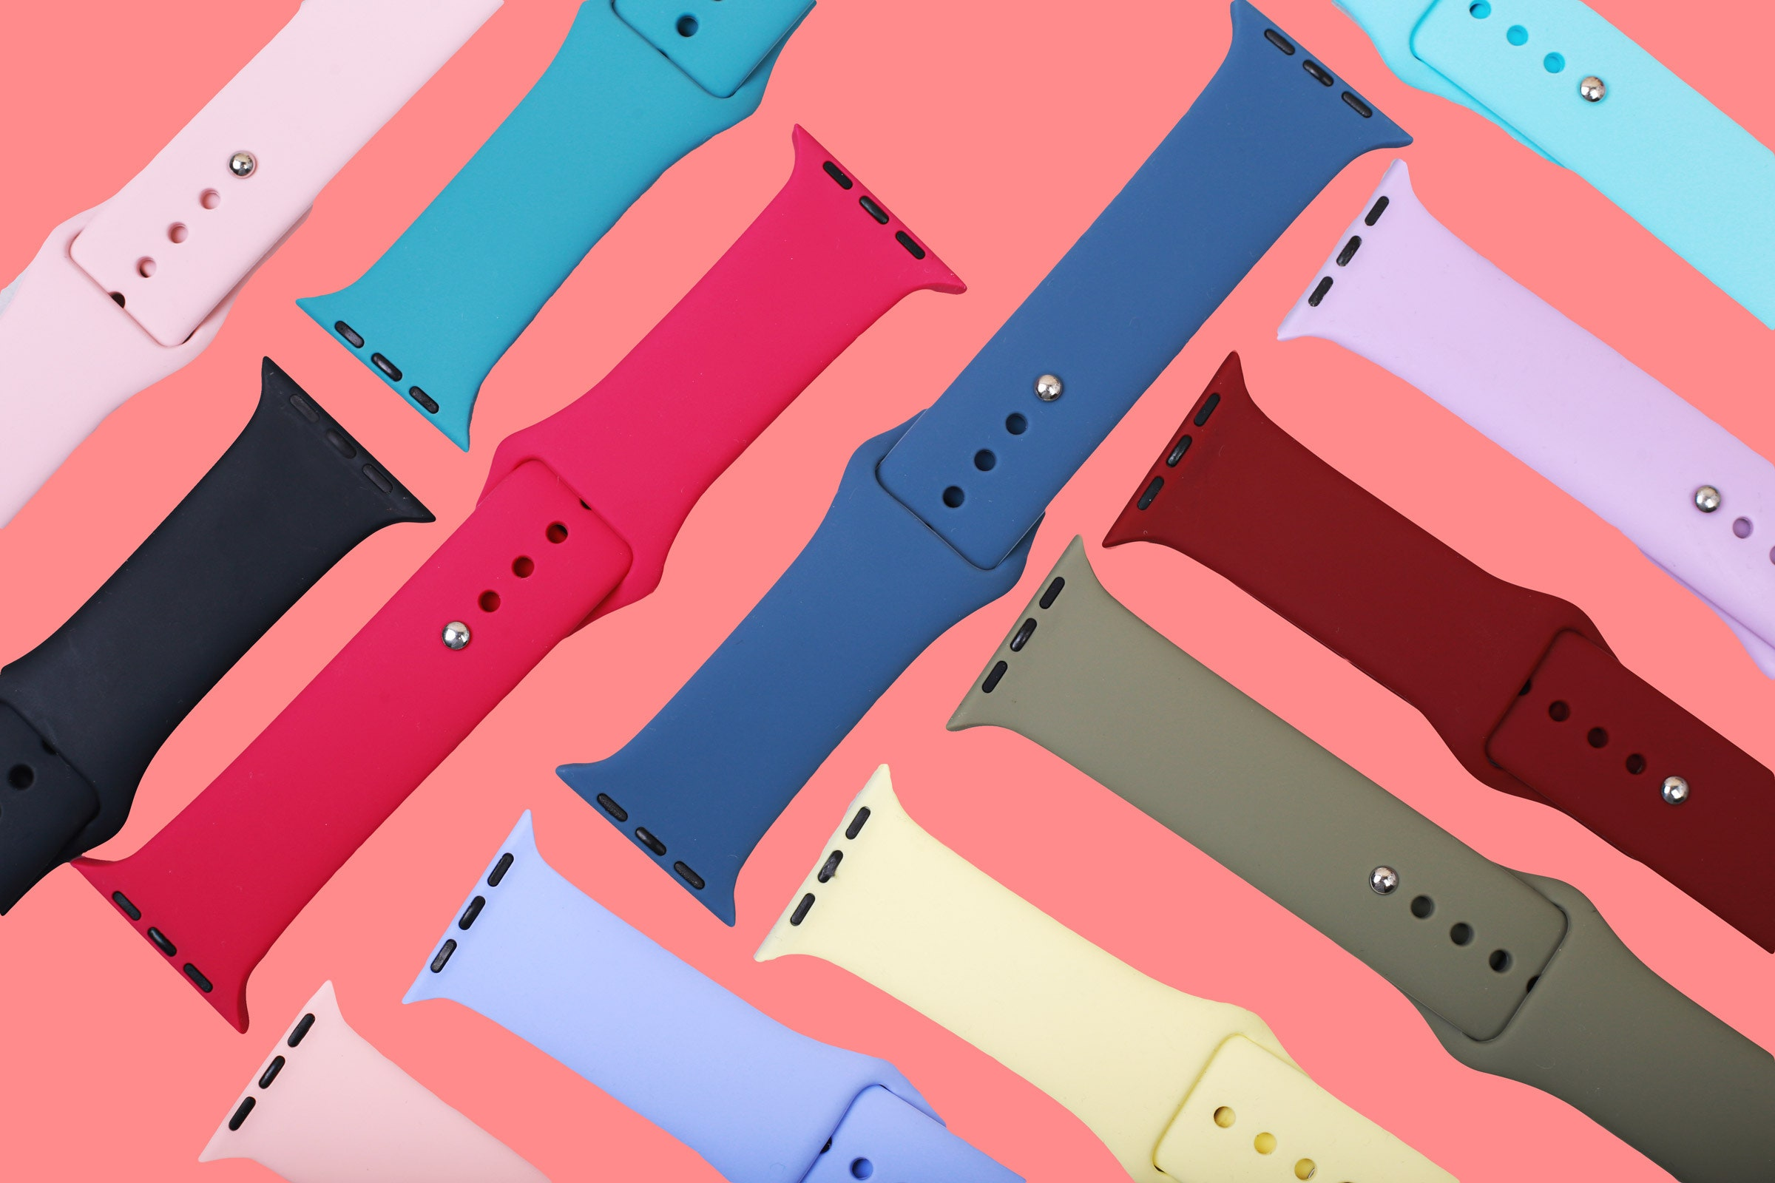
What is a Function ?

Slide 97
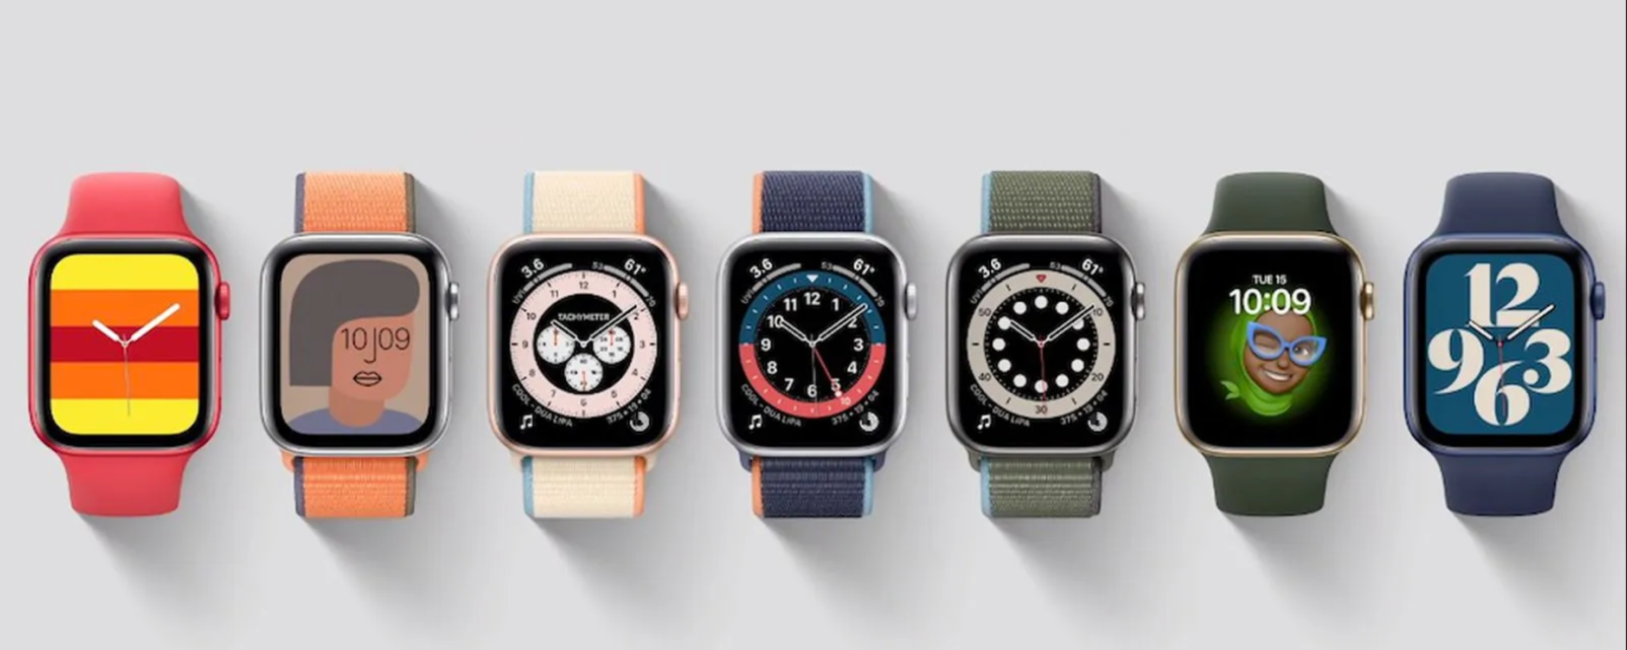

Slide 98
There are 2 types of Functions
Pre-Defined
Functions
User Defined
Functions

Slide 99
Pre-Defined Functions
Pre-Defined functions are the function types that specific for a programing language.
Ex : sqrt()

Slide 100
Problem 27
Write a program to print Square root of 16 using sqrt function
(import the math function)

Slide 101
User-Defined Functions
User-Defined functions are the function types that the user can customize & use it in anywhere of code.

Slide 102
There are 4 types of Functions
No Return
No Parameter
No Return
With Parameter
With Return
No Parameter
With Return
With Parameter

Slide 103
No Return – No Parameter
DataType validFunctionName()
{
//functionBody
}

Slide 104
Problem 28
Write a function to print 1 –100 using for loop and Call the function in Main Function
(use No return type no parameter method)

Slide 105
No Return – With Parameter
dataType validFunctionName(variable)
{
//functionBody
}

Slide 106
Problem 29
Write a function to find whether the entered number is odd or even.
(use No return type with parameter method)

Slide 107
Problem 30
Write a function to find the sum & average of two numbers that user inputs.
(use No return type with parameter method)

Slide 108
With Return – No Parameter
dataType validFunctionName()
{
//functionBody
return Value;
}

Slide 109
Problem 31
Write a function to find whether the entered number is odd or even.
(use With return type no parameter method)

Slide 110
With Return – With Parameter
dataType validFunctionName(dataType)
{
//functionBody
return Value;
}

Slide 111
Problem 32
Write a function to find whether the entered number is odd or even.
(use With return type With parameter method)

Slide 112

Thank You !

